Slide 1
Fremtidssalon, 19. april 2017
København år 2040

Slide 2
Hvordan ser verden ud i år 2040?

Slide 3
Sustainable development goals er gennemført

Slide 4
Ekstrem fattigdom
94%
10%

Slide 5
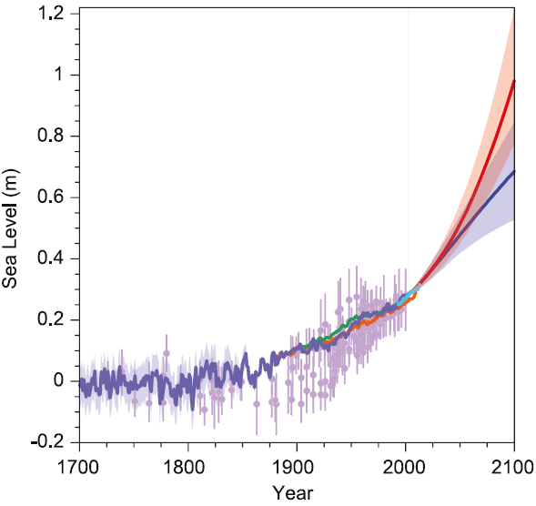
Havvandsstigninger?
Hvad betyder 15 cm højere vandstand?

Slide 6
Eksponential technologies præger vores hverdag
Meget billige eller gratis teknologier i år 2040 … hvad betyder det for markedet og vores hverdag?
Sensors / Internet of Things
Artificial Intelligence / Machine Learning
Robotics
Solar PV
Energy Storage
3D Printing
3D Visualisation
Mobile Internet & Cloud
Big Data / Open Data
Unmaned Aerial Vehicles / Nano Satellites
eMoney / eFinance

Slide 7
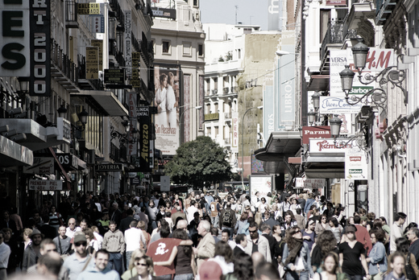
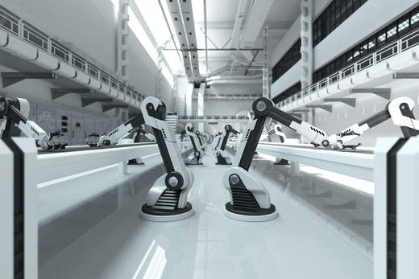
Hvilke mega-trends ser vi?
Megatrend
Relevance
Urbanisation
Value shifting to large and mega cities fuelling demand for urban infrastructure, waste, water etc. growing rapidly as well as city planning to design cities of the future
Accelerated demand for SMART solutions as already urbanized societies seek to improve and develop urban communities in a managed way
1
Economic centre of gravity moving to growth markets
Significant share of CAPEX shifting towards Asia
Financial instability depressing investment in countries with high debt and low growth
Emerging world competition rising to challenge incumbents
2
Automation and digitalisation
Automation across the value chain puts pressure on detailed design and can shift value pool towards software/technology providers
Digitalisation challenges established delivery models, moving value towards firms leveraging digital to improve services and productivity
3
The sustainability challenge
Renewables dominating the energy investment landscape, with value shifting towards delivery of renewable technology providers
Climate change increases demand for water, energy and environment services for mitigation and adaptation
Resource scarcity (including water) drives innovation and investment into new service offering
4
Mobility transformation
Rise of shared mobility and new mobility technologies (e.g., autonomous vehicles) fundamentally reshaping demand for transport infrastructure
Increasing interconnectedness/digitalisation creates arbitrage opportunities through more cross-border cooperation
5

Slide 8
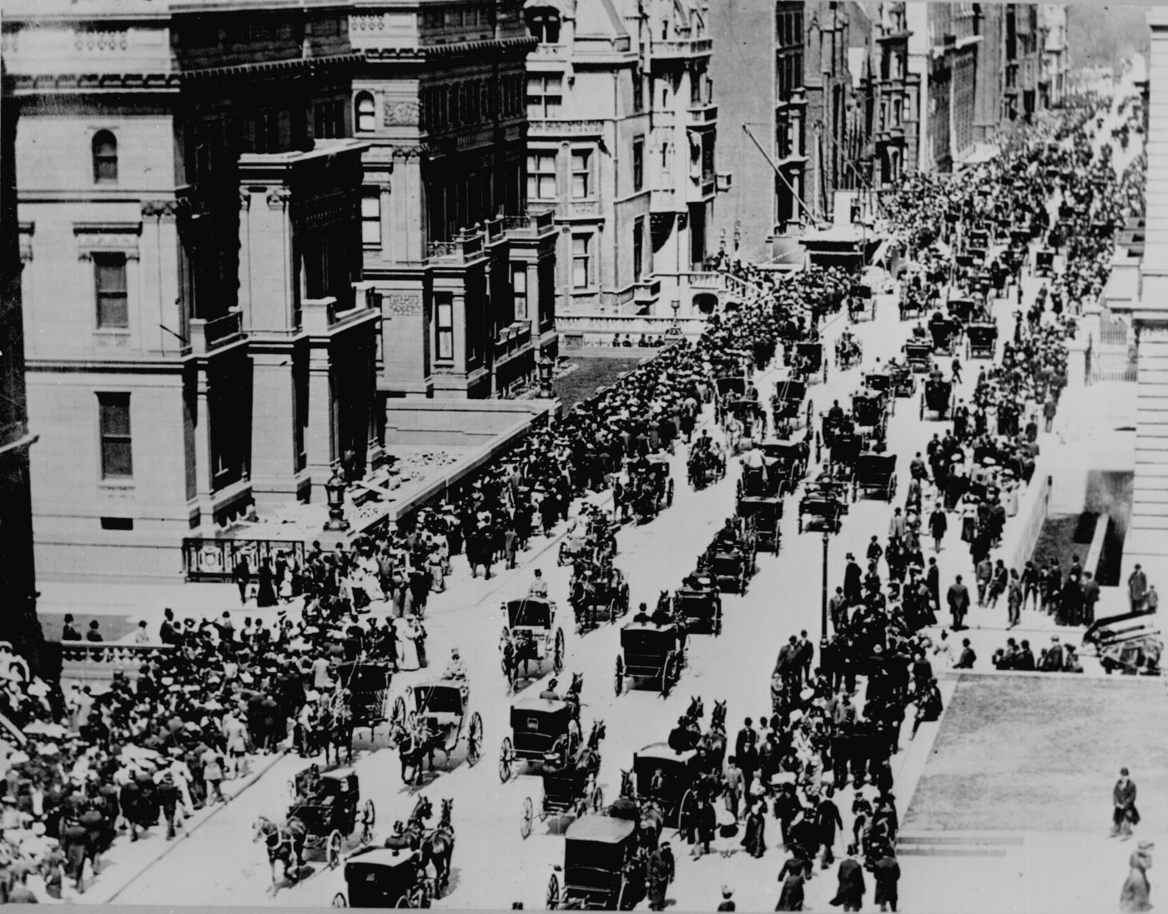
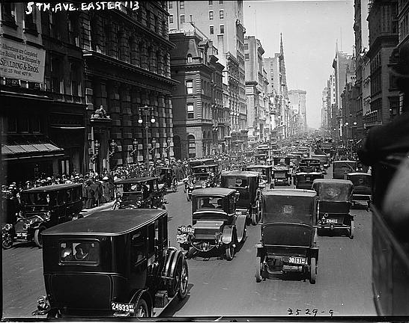
Hvor hurtigt vil udviklingen i virkeligheden gå?
New York Easter Parade 1905 og 1913 er et berømt eksempel

Slide 9
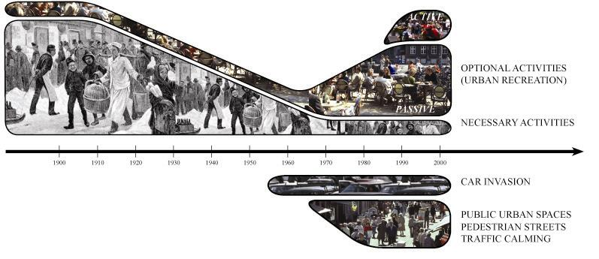
What is a city for?
Credit: Jan Gehl

Slide 10
Monocle’s liveability index

Slide 11
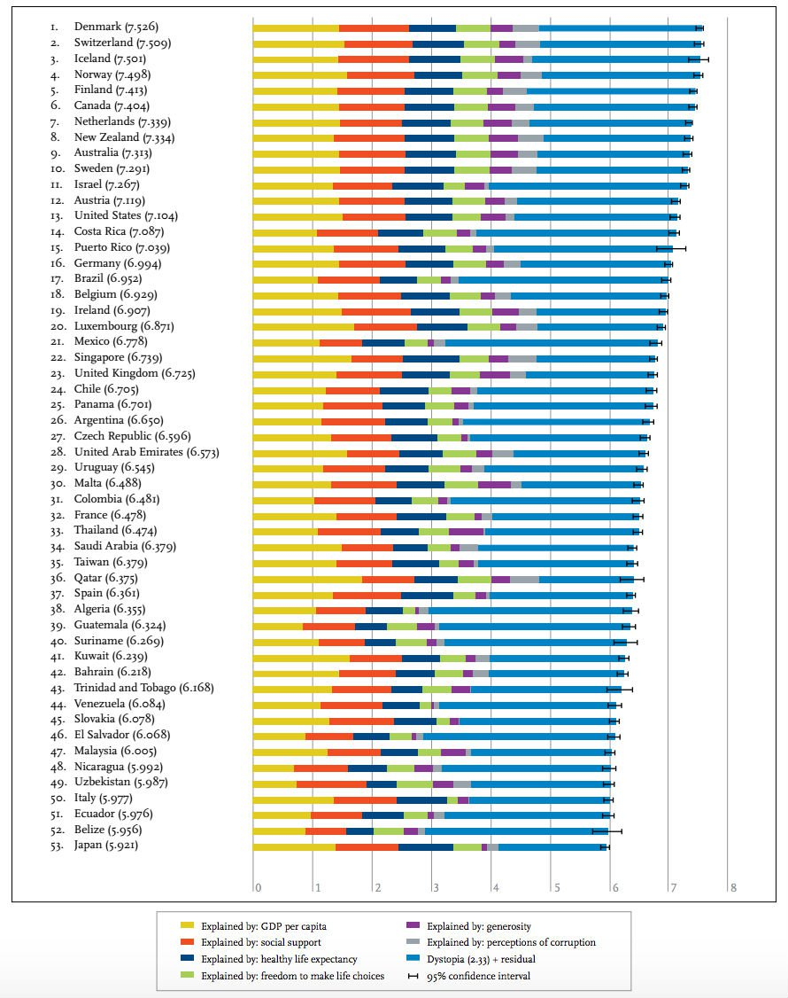
happiness index 2016

Slide 12
Sustainable city value chain
Growth
Knowledge
Innovation
Employment
Investments
Quality of life
Safe
Diverse
Leisure
Convenience
Sustainability
Carbon neutral
Clean air & water
Notes:
So what is the short message? The short message is that by investing in projects that makes cities more liveable, the quality of life will increase. This will attract people and jobs and new investments. From the city perspective this will result in more tax revenue meaning the city can then afford to invest in even more sustainability and liveability projects. This is the sustainable cities value chain that the Nordic cities has implemented successfully.

Slide 13
Befolkningsprognose for københavn
760.000
600.000
Kilde: kk.dk, statistikbanken

Slide 14
Hvad betyder det for byens udviklingsområder og infrastruktur?

Slide 15
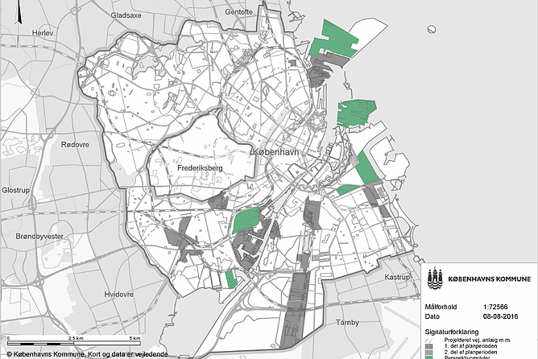

Slide 16
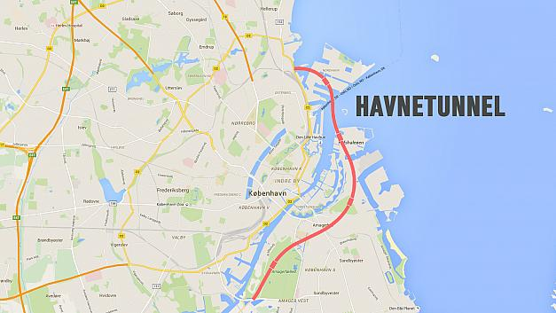

Slide 17
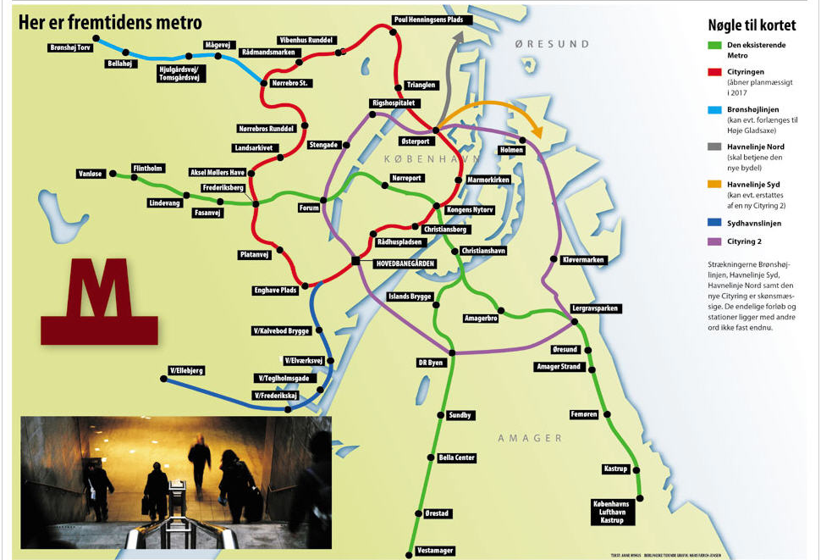

Slide 18
Tak

